Slide 1
802.11 带宽获取
zhangfei

Slide 2
带宽获取
802.11带宽概述
HT带宽配置
VHT带宽配置
HE带宽配置
HT/VHT带宽获取
HE带宽获取
note: 不包含 S1G(Sub 1 GHz), TVHT(Television very high throughput), CDMG(China directional multi-gigabit), CMMG(China millimeter-wave multi-gigabit) 等特殊场景;

Slide 3
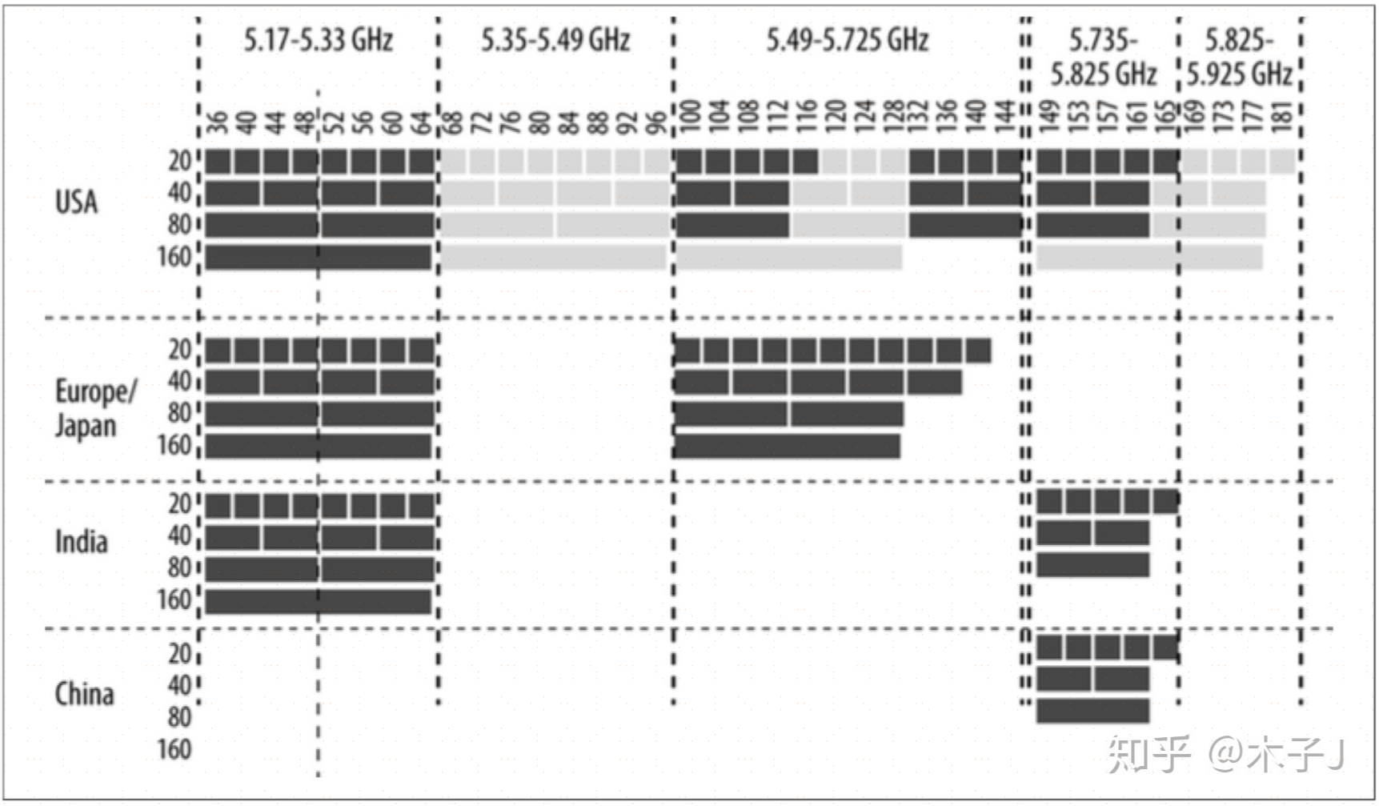
channel number

Slide 4
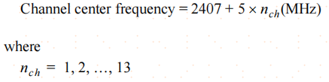
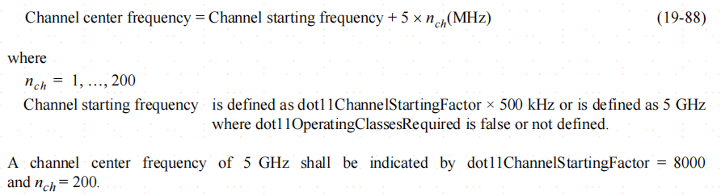
Channel center frequency
band上,每5MHz的信道被划分为一个channel
for 2.4GHz band
5 GHz band

Slide 5
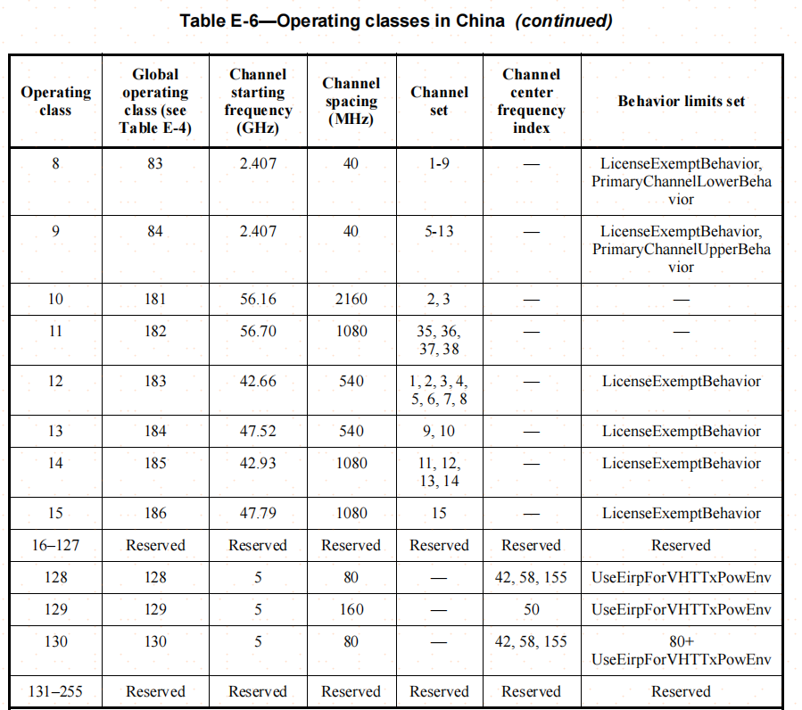
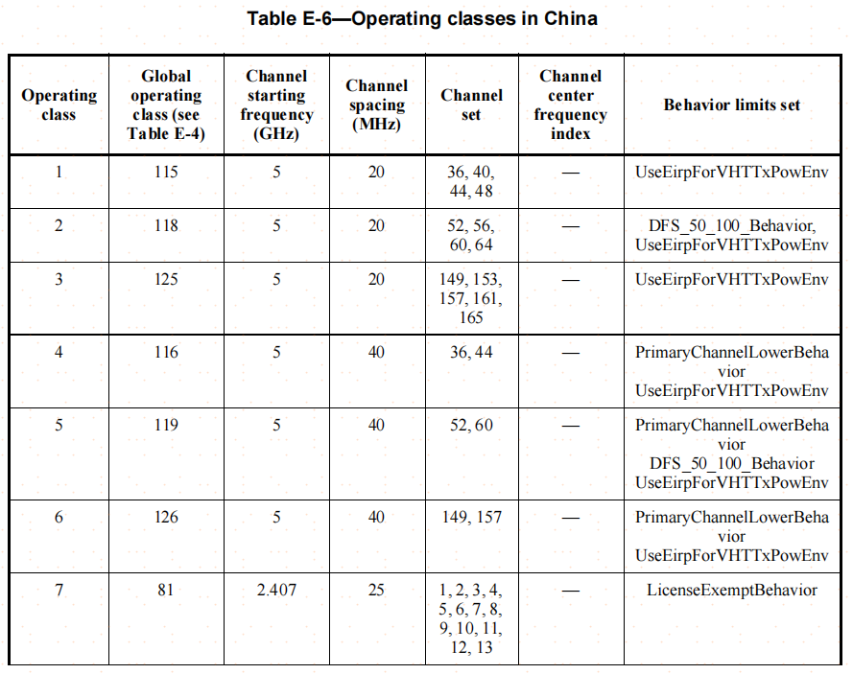
带宽配置

Slide 6
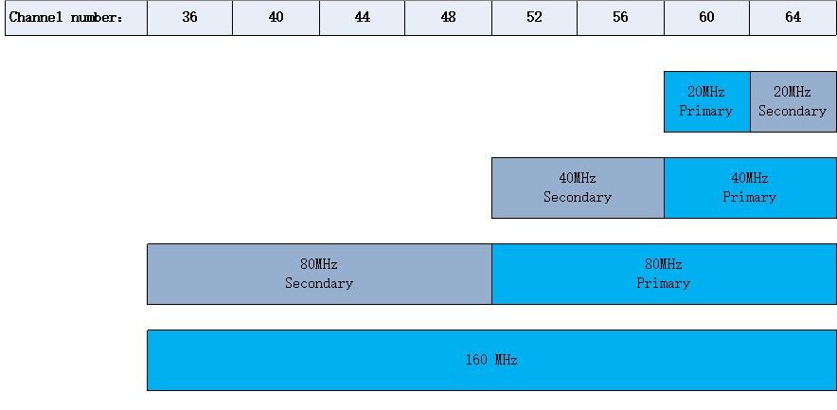
802.11带宽概述
信道带宽和信道划分
primary channel:
primary 20 MHz channel:
primary 40 MHz channel:
primary 80 MHz channel:
secondary 20 MHz channel:
secondary 40 MHz channel:
secondary 80 MHz channel:
主辅信道相对位置
SCA: secondary channel above
SCB: secondary channel below
SCN: no secondary channel

Slide 7
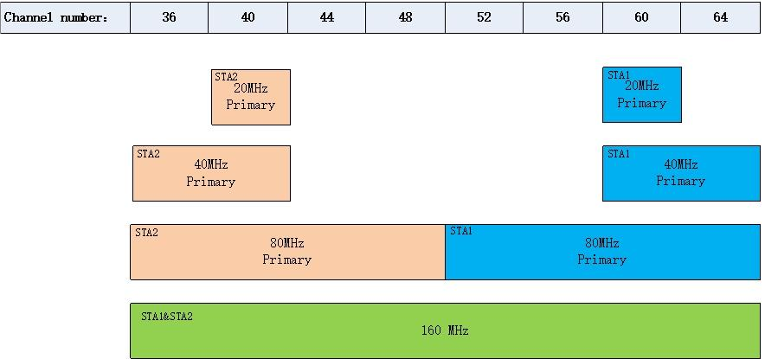
802.11带宽概述
频率空间共享(example)
给多个STA/AP置配置最大160M
的带宽；
同时给这些STA/AP配置80M,40
M,20M的带宽，且在频域上不重叠
实际工作时并不需要一直使用160
M的大带宽
可以同时使用80M的带宽实现共
享整个160M带宽

Slide 8
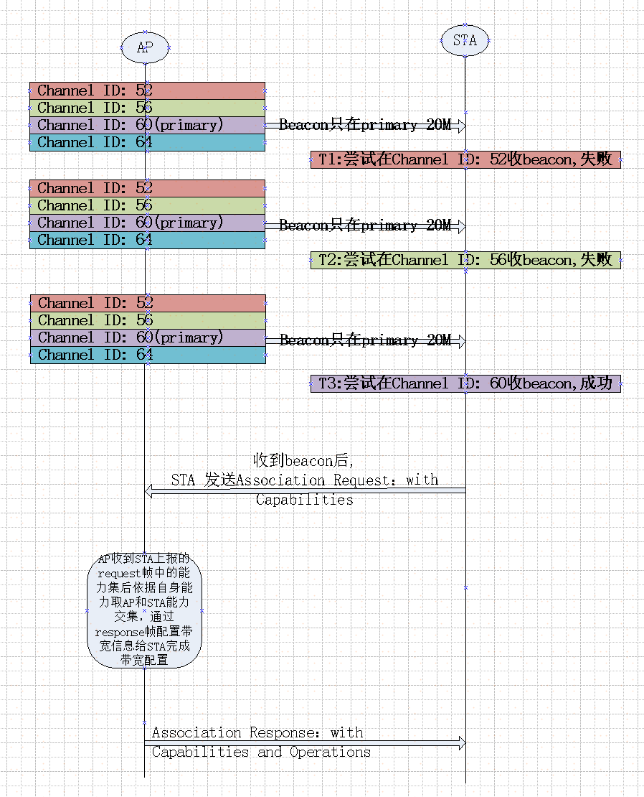
802.11带宽配置----流程
带宽配置通过如下elements在AP和STA直接交互：
Capabilities指示AP/STA的带宽能力
HT Capabilities
VHT Capabilities
HE Capabilities
Operation element指示AP的详细带宽配置
HT Operation element
VHT Operation element
HE Operation element
这些element可能包含在下列管理帧中：
Beacon: 中包含capabilities 和operations
Association Request: capabilities
Association Response: capabilities + operations
Reassociation Request: capabilities
Reassociation Response: capabilities + operations
Probe Request: capabilities
Probe Response: capabilities + operations

Slide 9
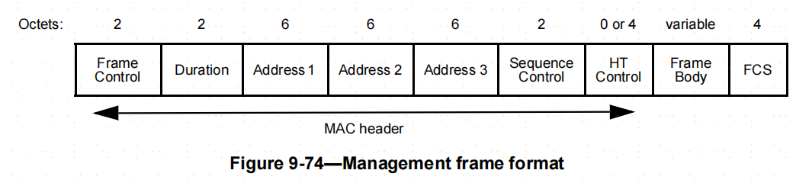
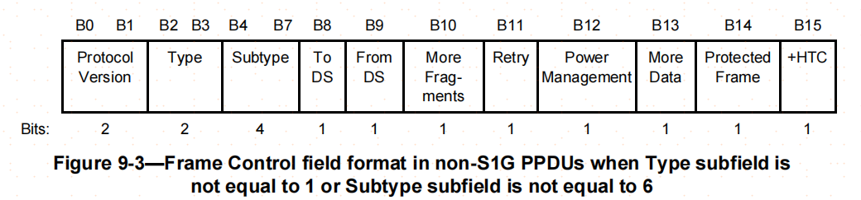
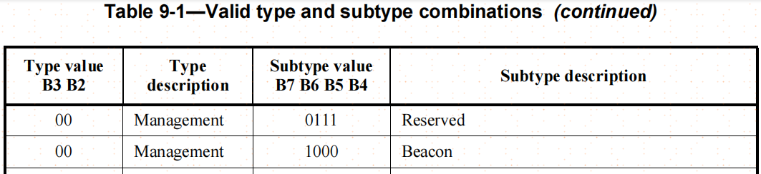
802.11带宽配置----管理帧
Beacon帧帧结构

Slide 10
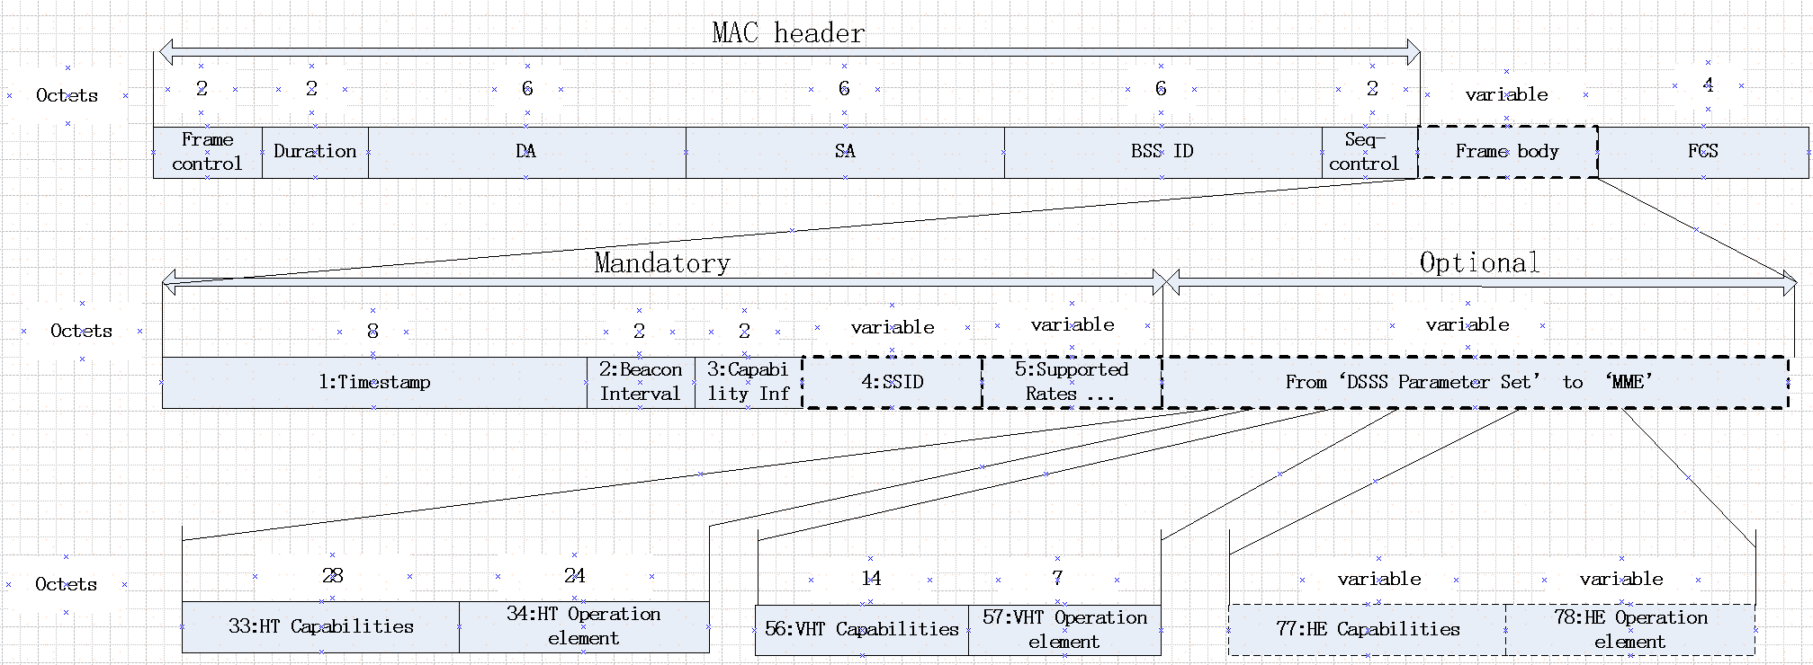
802.11带宽概述----beacon帧
NOTE：
图中各field和element前的数字表示在这些field和element在beacon帧frame body中的order，不是element ID.

Slide 11
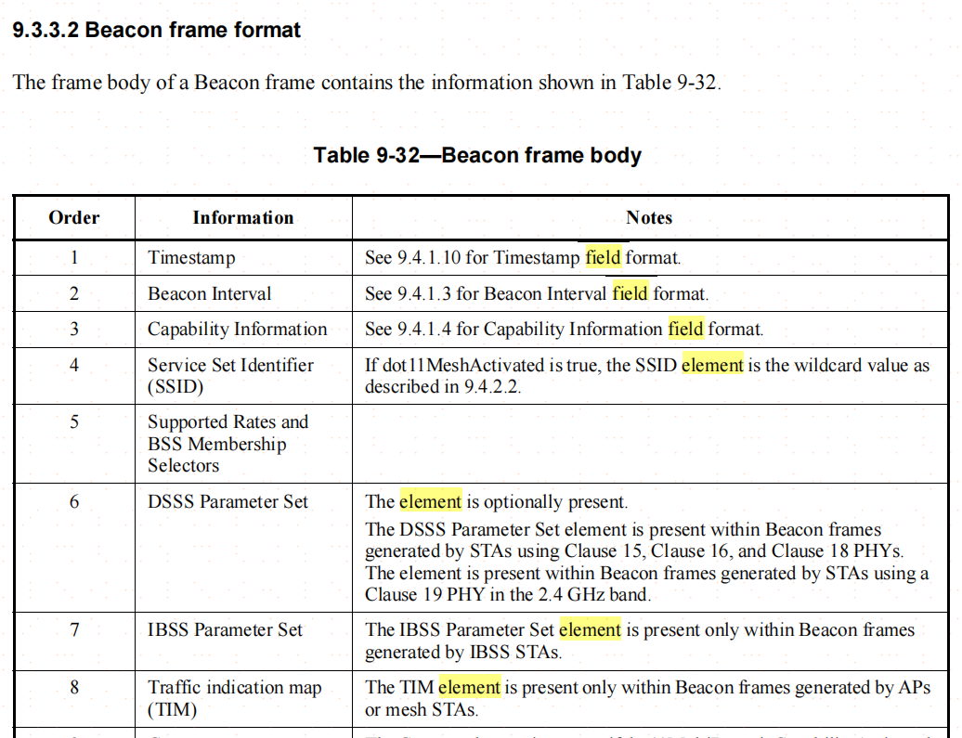
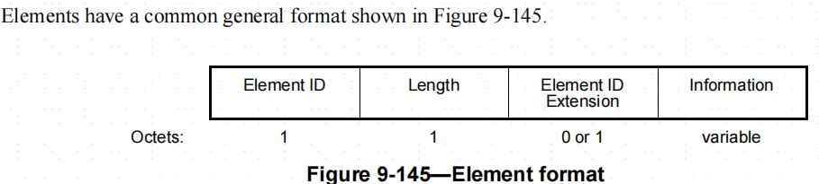
802.11带宽概述----beacon帧
frame body中有field和element两种信元组成；
frame body中个信元分为必选项和可选项
fields有各自的格式；
elements有统一的格式，每个element有对应的element ID，这些element在不同的管理层的frame body中对应的order可以不一样；
fields在elements前面，且在frame body中field需要按顺序放置
frame body中个element的顺序理论上可以不按照表中的order顺序填写，通过各个element的格式可以依次解析
旧版本中的STA/AP收到新版本STA/AP发生的beacon中可能解析出无法识别的element，只需将其丢弃，不影响后续element的解析

Slide 12
802.11带宽配置----association，probe帧
Association Request，Association Response，Reassociation Request，Reassociation Response，Probe Request以及Probe Response的帧结构和beacon帧类似，不再一一赘述

Slide 13
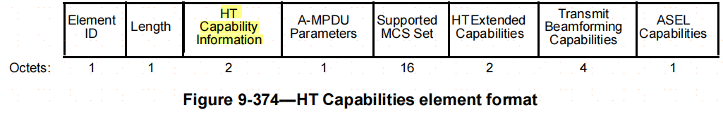
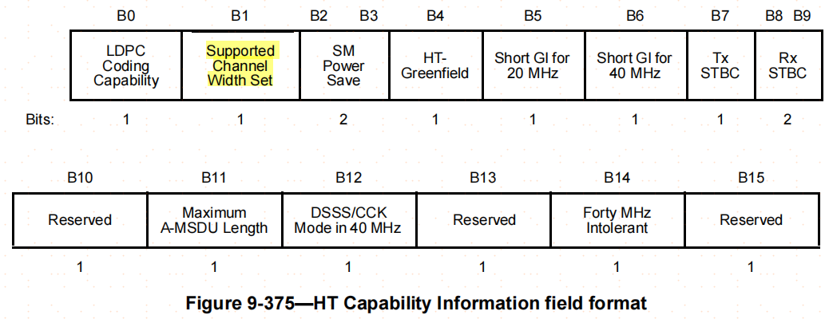
802.11带宽配置----HT Capabilities
Element ID=45
Length=28
Supported Channel Width Set：
0:only 20 MHz operation is supported
1:both 20 MHz and 40 MHz operation is supported

Slide 14
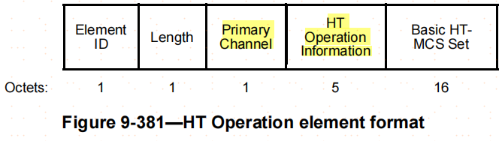
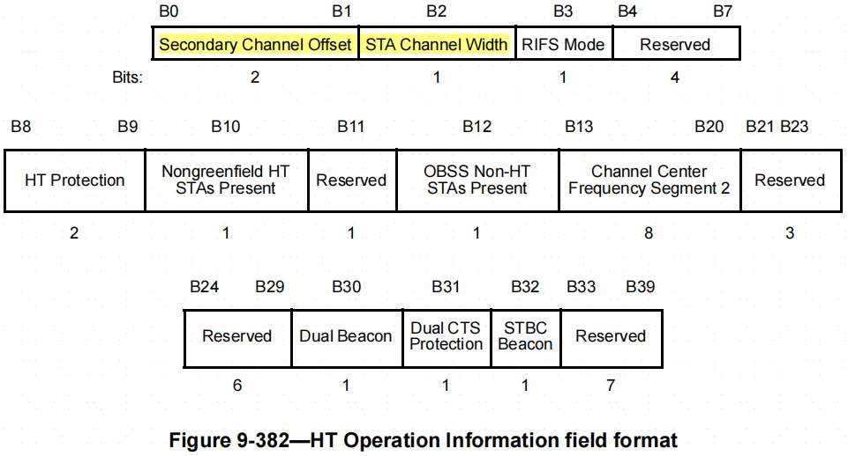
802.11带宽配置----HT Operation
Element ID=61
Length=24
Primary Channel： Channel number of the primary channel
Secondary Channel Offset：
0：no secondary channel is present(SCN)
1：secondary channel is above the primary channel(SCA)
3：secondary channel is below the primary channel(SCB)
2：reserved
STA Channel Width
0: 20 MHz channel width only
1: allows use of any channel width in the Supported channel width set

Slide 15
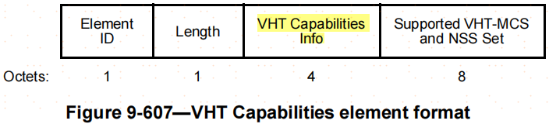
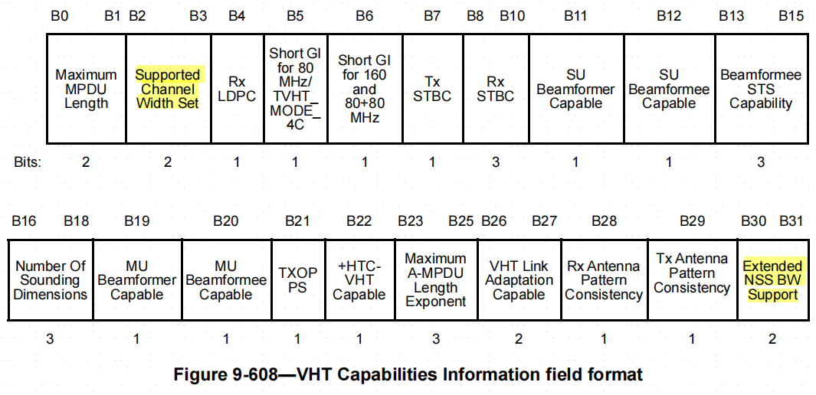
802.11带宽配置----VHT Capabilities
Element ID=191
Length=14
Supported Channel Width Set：
0:160 MHz operation is not supported;
1: only 160 MHz is supported
2: 160 MHz and 80+80 MHz; are supported;
3: reserved;
Extended NSS BW Support: Together with the Supported Channel Width Set subfield and Supported VHT-MCS and NSS Set field, indicates the channel widths and maximum NSS values per width supported by the STA

Slide 16
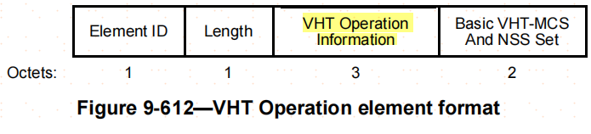
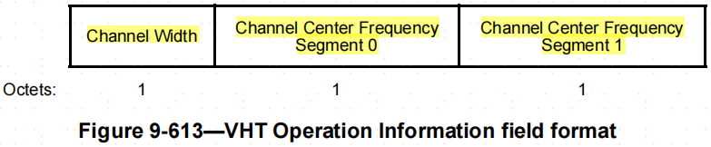
802.11带宽配置----VHT Operation（part1）
Element ID=192
Length=7
Channel Width：together with the HT Operation element STA Channel Width field, defines the BSS bandwidth
0: 20MHz or 40MHz
1: 80MHz or 160MHz or 80+80 MHz
2: 160MHz
3: 80+80 MHz

Slide 17
802.11带宽配置----VHT Operation（part2）
Channel Center Frequency Segment 0：
20, 40, or 80 MHz: the channel center frequency index；
For 160 MHz & Width subfield equal to 1: channel center frequency index of the primary 80 MHz channel segment that contains the primary channel；
For 160 MHz & Width subfield equal to 2: channel center frequency index of the 160 MHz channel ；
For 80+80 MHz & Width subfield equal to 1 or 3: channel center frequency index for the primary 80 MHz channel；

Slide 18
802.11带宽配置----VHT Operation（part3）
Channel Center Frequency Segment 1：
20, 40, or 80 MHz: set to 0
160 MHz & Width subfield equal to 1: channel center frequency index of the 160 MHz
160 MHz & Width subfield equal to 2: set to 0.
80+80 MHz & Width subfield equal to 1 or 3: channel center frequency index of the secondary 80 MHz channel

Slide 19
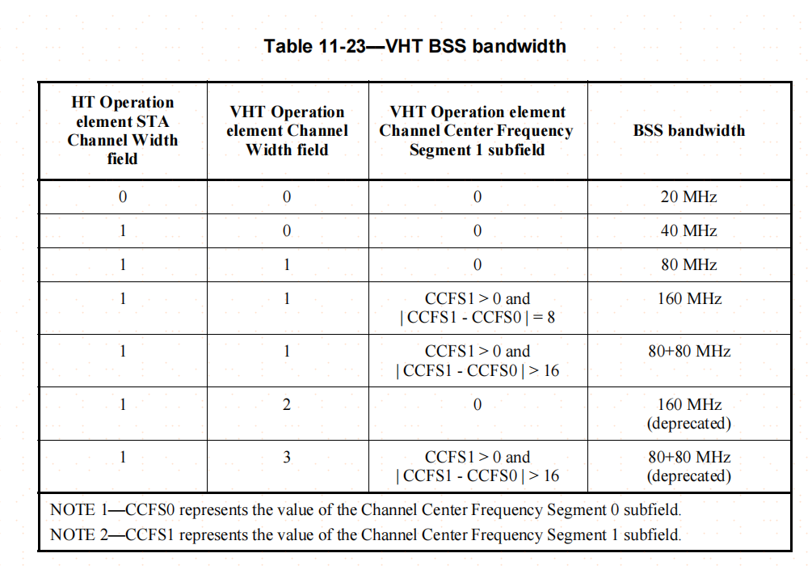
802.11带宽配置----VHT Operation（part4）
NOTE: primary 20MHz的中心频点一直是知道的；

Slide 20
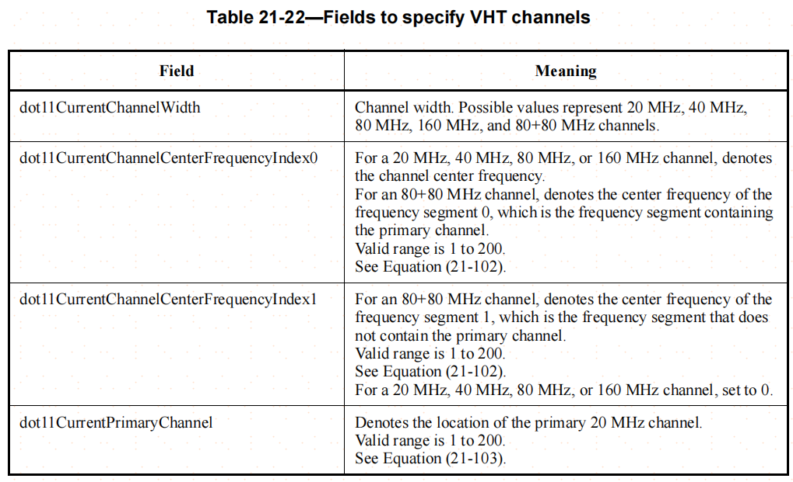
802.11带宽配置----相关系统参数配置（part1）

Slide 21
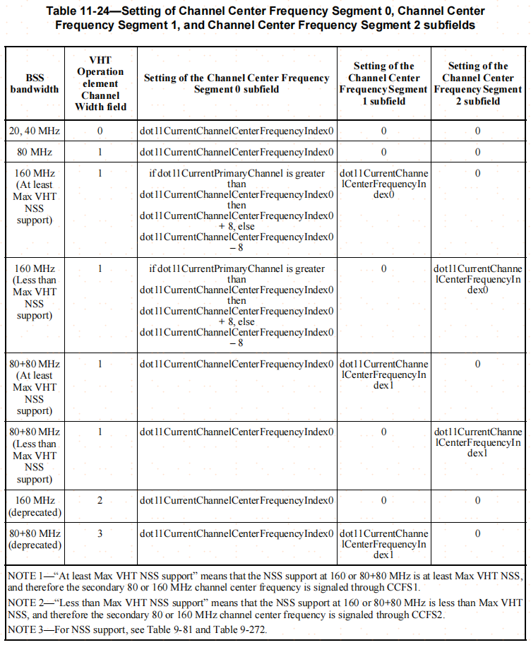
802.11带宽配置----相关系统参数配置（part2）

Slide 22
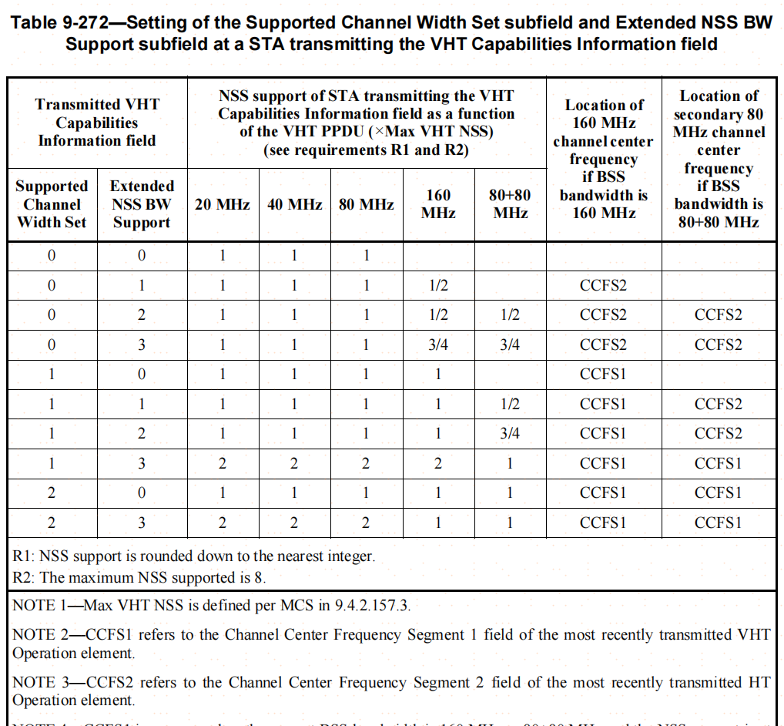
802.11带宽配置----相关系统参数配置（part3）

Slide 23
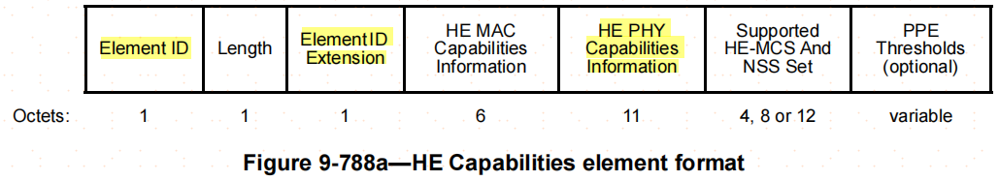
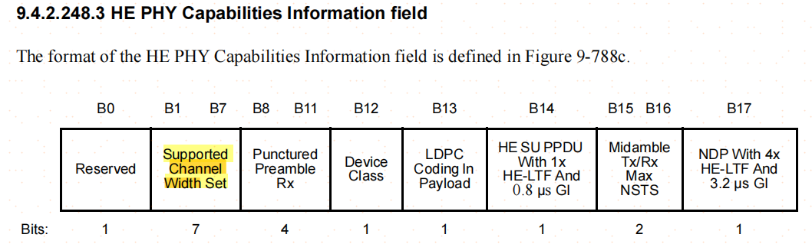
802.11带宽配置----HE Capabilities(part1)
Element ID=255
Element ID Extension = 35
Length= 不定长
‘Supported Channel Width Set’ for 2.4GHz band：
B0:
0: 40MHz NOT supported
1: 40MHz supported
B1, B2, and B3 are reserved
B4: only for non-AP STA
1: support of 242-tone RUs in a 40 MHz HE MU PPDU if a non-AP STA operates with a 20 MHz channel width and the '20 MHz In 40 MHz HE PPDU In 2.4 GHz' subfield is 1
0: otherwise
B5 and B6 are reserved

Slide 24
802.11带宽配置----HE Capabilities(part2)
‘Supported Channel Width Set’ for 5 GHz and 6 GHz bands:：
B0: reserved
B1:
1: support for a 40 MHz and 80 MHz channel width
0: NOT support
B2:
1: support for a 160 MHz channel width 0: NOT support
B3:
1: support for a 160/80+80 MHz channel width
0: NOT support
B4 reserved
B5: only for non-AP STA
1: support of 242-tone RUs in a “40 MHz and 80 MHz HE MU PPDU if a non-AP STA operates with 20 MHz channel width and the ‘20 MHz In 160/80+80 MHz HE PPDU subfield’ is set to 0” or “40 MHz, 80 MHz, 160 MHz, 80+80 MHz HE MU PPDU if a non-AP STA operates with 20 MHz channel width and ‘the 20 MHz In 160/80+80 MHz HE PPDU subfield’ is set to 1”
0: otherwise
B6 reserved

Slide 25
802.11带宽配置----HE Capabilities(part3)
20 MHz In 40 MHz HE PPDU In 2.4 GHz Band：reserved for an AP
1: support for 26-, 52-, and 106-tone RU mapping for a 20 MHz operating non-AP HE STA that is the receiver of a 40 MHz HE MU PPDU in 2.4 GHz band, or the transmitter of a 40 MHz HE TB PPDU in 2.4 GHz band
0: NOT support
20 MHz In 160/80+80 MHz HE PPDU: reserved for an AP
1: support for 26-, 52-, and 106-tone RU mapping for a 20 MHz operating non-AP HE STA that is the receiver of an 80+80 MHz or a 160 MHz HE MU PPDU, or the transmitter of an 80+80 MHz or 160 MHz HE TB PPDU
0: NOT support
80 MHz In 160/80+80 MHz HE PPDU: reserved for an AP
1: supports of 160/80+80 MHz OFDMA for a non-AP HE STA that sets B1 of Supported Channel Width Set to 1, and sets B2 and B3 of Supported Channel Width Set each to 0, when operating with 80 MHz channel width
0: NOT support;

Slide 26
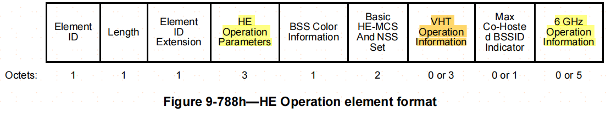
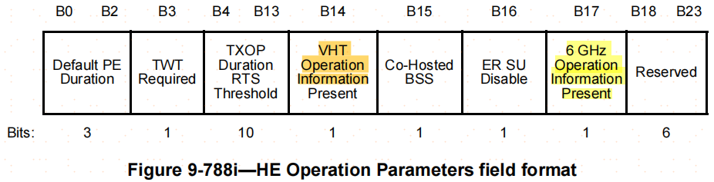
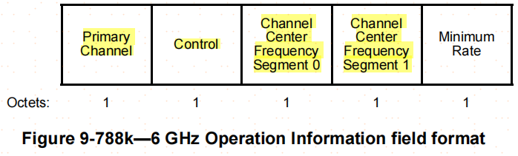
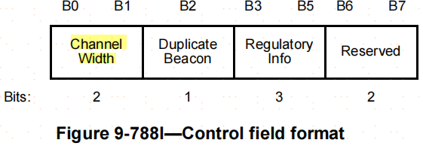
802.11带宽配置----HE Operation（part1）
Element ID=255
Element ID Extension = 36
Length= 不定长
VHT Operation Information:
由‘HE Operation Parameters’ field指示是否配置，‘VHT Operation Information’请参考上面的章节.
6GHz Operation Information：
由‘HE Operation Parameters’ field指示是否配置
Primary Channel：indicates the channel number of the primary channel in the 6 GHz band.
Channel Width：indicates the BSS channel width and is set to 0 for 20 MHz, 1 for 40 MHz, 2 for 80 MHz, and 3 for 80+80 or 160 MHz.

Slide 27
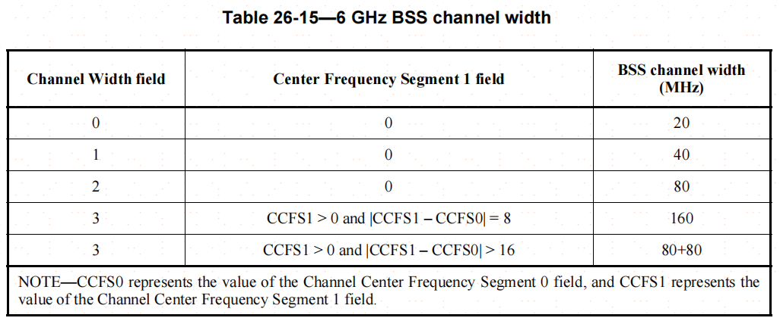
802.11带宽配置----HE Operation（part2）
6GHz Operation Information：
Channel Center Frequency Segment 0 field: indicates the channel center frequency index for the 20 MHz, 40 MHz, 80 MHz, 160 MHz, or 80+80 MHz channel on which the BSS operates in the 6 GHz band. If the BSS channel width is 160 MHz or 80+80 MHz, then the Channel Center Frequency Segment 0 field indicates the channel center frequency index of the primary 80 MHz.
Channel Center Frequency Segment 1 field: indicates the channel center frequency index of the 160 MHz channel on which the BSS operates in the 6 GHz band. If the channel width is 80+80 MHz, then it indicates the channel center frequency index of the secondary 80 MHz.

Slide 28
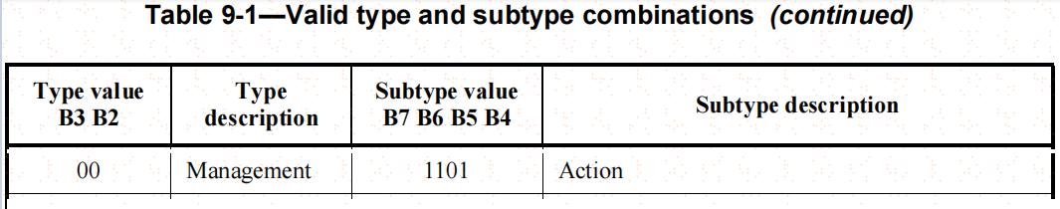
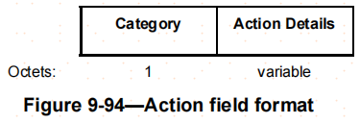
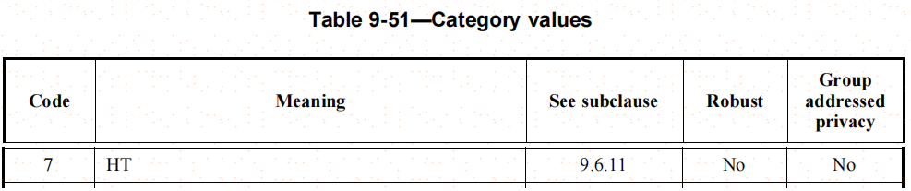
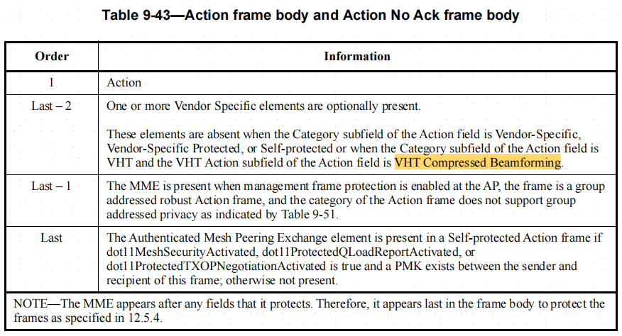
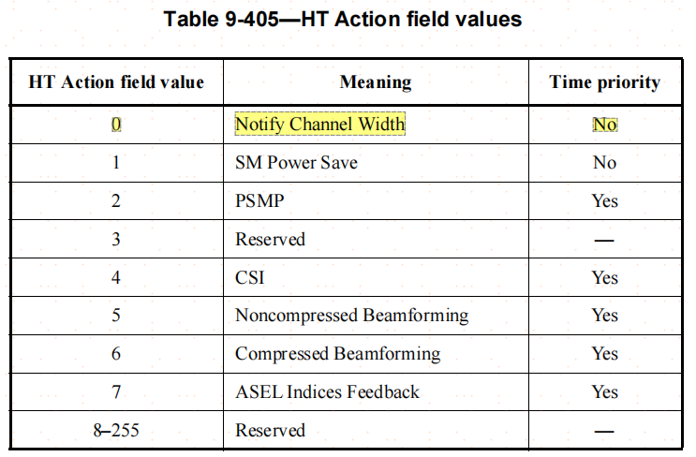
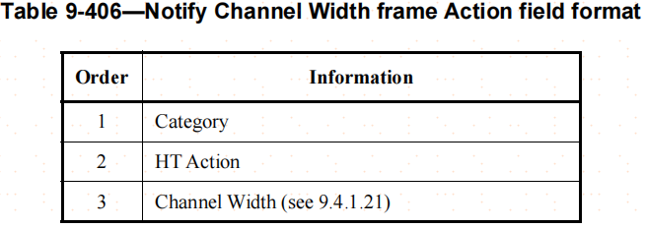
802.11带宽配置----Notify Channel Width
Notify Channel Width frame:
A STA sends the Notify Channel Width frame to another STA if it wants to change the channel width of frames that the other STA sends to it

Slide 29
802.11带宽配置----Channel Switch（part1）
AP在工作过程中可能感知到当期工作channels存在干扰，或者避开雷达信号等原因需要触发信道切换， 并且尽可能的减小对管理STAs的影响，目的channel的选取算法此次不讨论；
channel Switch可以通过:
Channel Switch Announcement frame 这个Spectrum Management Action frame帧修改STA的channel；
The Address 1 field of a Channel Switch Announcement frame shall be set to the broadcast address
Extended Channel Switch Announcement frame这个Public Action frame帧修改某个STA的channel；
The Address 1 field of a Channel Switch Announcement frame shall be set to the broadcast address
beacon帧中包含Channel Switch Anouncement或Extended Channel Switch Announcement广播到所有的STA修改channel；

Slide 30
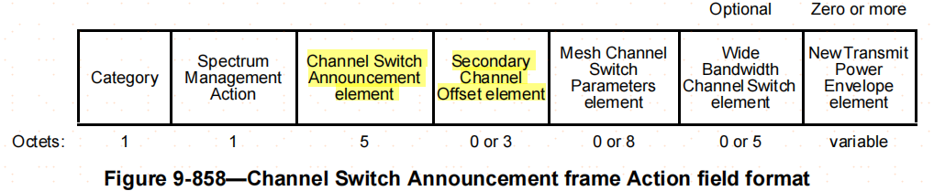
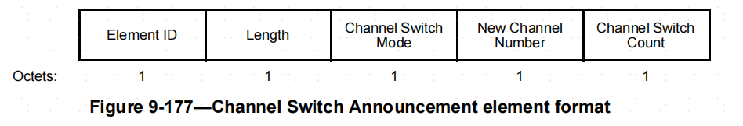
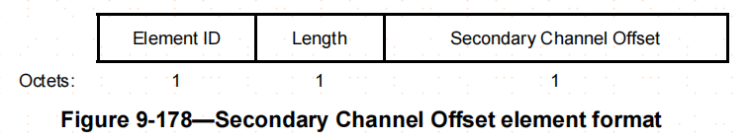
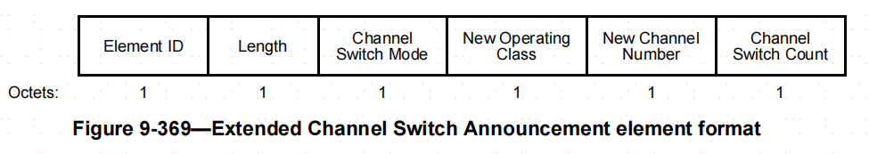
802.11带宽配置----Channel Switch（part2）
Channel Switch Announcement element Element ID=37；
extended Channel Switch Announcement element Element ID=60；
Channel Switch Mode： 1,中断AP与STA的数据传输直到switch完成；
New Channel Number：切换的目的channel number；
Channel Switch Count：在 channel switch counter个TBTT后进行信道切换（target beacon transmission time）；
The Secondary Channel Offset element Element ID=62
Secondary Channel Offset:
0: SCN；1: SCA；3: SCB；other: reserved

Slide 31
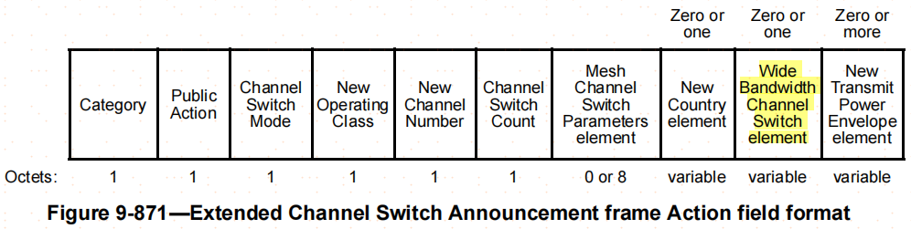
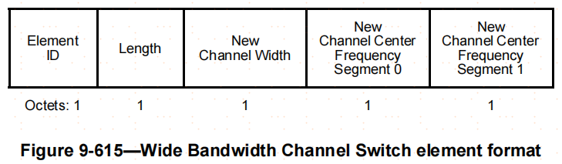
802.11带宽配置----Channel Switch（part3）
Extended Channel Switch Announcement frame帧格式（属于public action帧）添加了operation Class元素以；
Wide Bandwidth Channel Switch element格式：添加了超过40M带宽的 channel switch元素
相关元素定义保持和association流程中使用到的一致；
note：Channel Switch Announcement frame和beacon frame都是广播消息，需要各STA依据广播frame的相关element自适应调整带宽信息以适配自身STA 能力. AP在switch channel后仍然需要依据STA的能力给STA分配信道带宽；

Slide 32
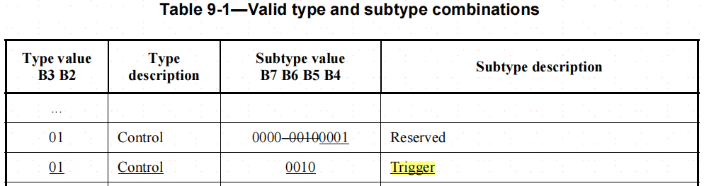
带宽配置获取
for HT, VHT: RTS & CTS
for HE:Trigger-MU-RTS，RTS & CTS

Slide 33
802.11带宽获取----HT
Dual CTS protection procedure：
according ot 802.11-2020：The dual CTS mechanism is obsolete. Support for this mechanism might be removed in a later revision of the standard；
A VHT STA shall not transmit VHT PPDUs in a TXOP protected by dual CTS protection.
A VHT AP shall not transmit an HT Operation element with the Dual CTS Protection field set to 1;
简单来说HT模式下，dual CTS就是用来获取整个40M带宽用的，primary 20M和secondary 20M带宽都需要用RTS/CTS占住带宽。
note:
个人理解升到到VHT以后的协议，不需要在使用dual CTS protection procedure了直接使用下面的VHT RTS/CTS procedure。

Slide 34
802.11带宽获取----VHT/HE
AP/STA依据自身带宽配置通过Beacon， Association等流程交互了各自的带宽配置以及相关能力。传统的802.11协议中RTS/CTS机制(只在primary channel上收发)用于处理隐藏终端的问题，在VHT模式以后，可以借用RTS/CTS机制处理动态的信道分配，这个过程称为带宽获取。
带宽获取过程有两个重要的概念：
non-HT duplicated frame：非HT的方式发送(只在primary channel发送)，且被复制多份在除primary channel以外的channel上发送；
bandwidth signaling transmitter address (TA): indicate the presence of additional signaling related to the bandwidth to be used in subsequent transmission，set by MAC layer with ‘Individual/Group bit’ set to 1;
note:
For the purposes of comparison in this standard(802.11), the MAC address is encoded as 6 octets, taken to represent an unsigned integer.The first octet of the MAC address shall be used as the most significant octet. This results in a sequence of 48 bits represented such that bit 0 is the first transmitted bit (Individual/Group bit) and bit 47 is the last transmitted bit.
When the CTS frame is a response to an RTS frame, the RA field of the CTS frame is set to the address from the TA field of the RTS frame with the Individual/Group bit set to 0.

Slide 35
802.11带宽获取----VHT/HT RTS/CTS（part1）
RTS TXVECTOR 由发送端的MAC层提供给发送端的PHY层，包含三个相关参数：
CH_BANDWIDTH = 实际尝试获取的带宽
CH_BANDWIDTH_IN_NON_HT = CH_BANDWIDTH
DYN_BANDWIDTH_IN_NON_HT = dynamic or static
CTS TXVECTOR由接收端的PHY通过解码PHY数据，提供给接收端MAC层， 同样也包含CH_BANDWIDTH，CH_BANDWIDTH_IN_NON_HT以及DYN_BANDWIDTH_IN_NON_HT三个参数，具体取值及使用过程如下：
DYN_BANDWIDTH_IN_NON_HT = DYN_BANDWIDTH_IN_NON_HT from RTS
if DYN_BANDWIDTH_IN_NON_HT = static
if all secondary channels indicated by CH_BANDWIDTH from RTS are available
CH_BANDWIDTH=CH_BANDWIDTH_IN_NON_HT=CH_BANDWIDTH_from_RTS
else ‘shall not respond with a CTS frame’
if DYN_BANDWIDTH_IN_NON_HT = dynamic
if some secondary channels indicated by CH_BANDWIDTH from RTS are available
CH_BANDWIDTH=CH_BANDWIDTH_IN_NON_HT=all_availabled_channels
else ‘shall not respond with a CTS frame’
Notes:
NOTE—On reception, where valid, the CH_BANDWIDTH_IN_NON_HT parameter is likely to be a more reliable indication of subformat and channel width than the NON_HT_MODULATION and CH_BANDWIDTH parameters, since for non-HT or non-HT duplicate frames, CH_BANDWIDTH is a receiver estimate of the bandwidth, whereas CH_BANDWIDTH_IN_NON_HT is the signaled bandwidth.

Slide 36
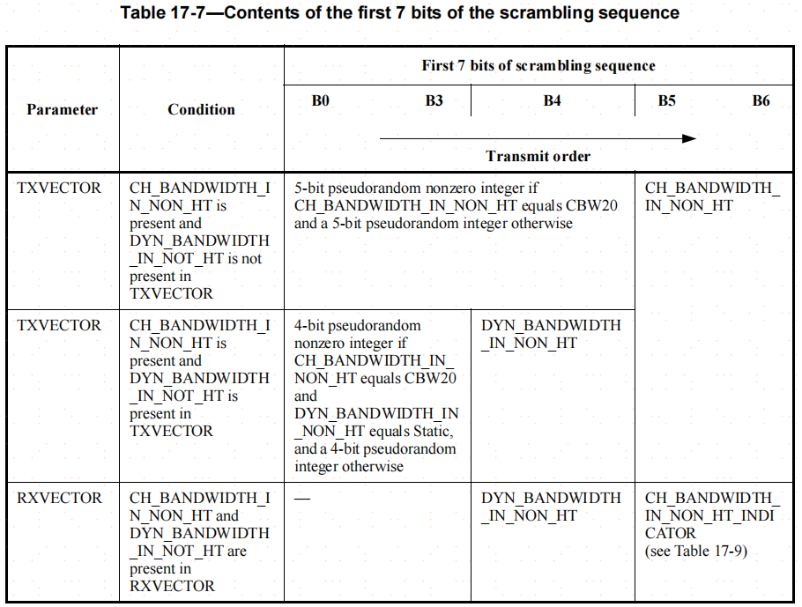
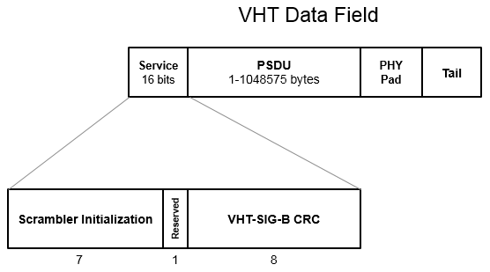
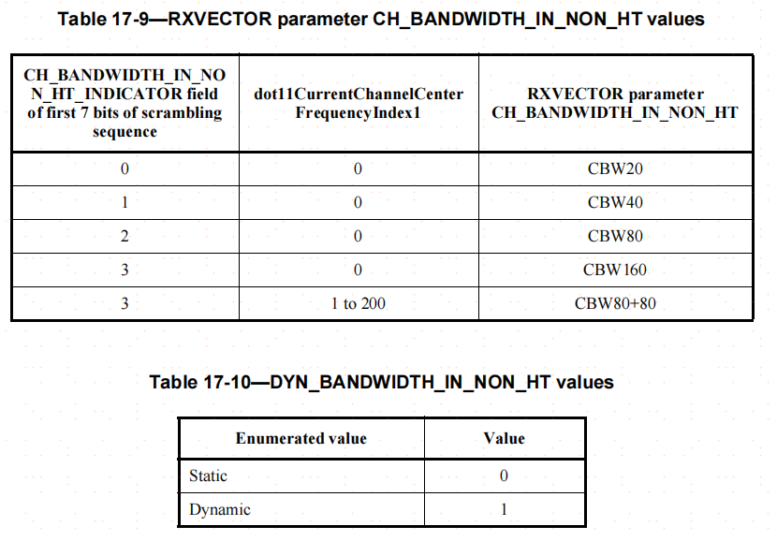
802.11带宽获取----VHT/HT RTS/CTS（part2）

Slide 37
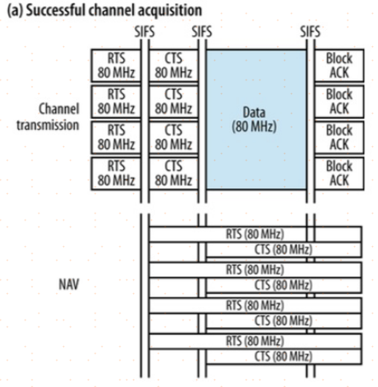

802.11带宽获取----VHT/HT RTS/CTS（part3）
下面两个例子用于描述借助RTS/CTS流程完成带宽获取的过程；

Slide 38
802.11带宽获取----VHT/HT RTS/CTS（part4）
在发送RTS前， 发送端依据自身的带宽配置（以及接收端之前反馈的带宽配置情况）和待发送的数据量大小等信息选择需要发送RTS和‘non-HT duplicated RTS frame’的带宽（这个功能应该是要在AP MAC软件部分实现）；
接收端收到这些RTS后，依据RXVECTOR的参数依据实际带宽配置和干扰情况正确反馈CTS；
在发送端收到接收端反馈的CTS后即可确定后续数据流程实际使用的带宽；

Slide 39
802.11带宽获取----HE MU-RTS Trigger/CTS(part1)
802.11ax 中由AP对带宽进行分配，在每次分配前应该依据AP自身带宽配置能力以及待调度STA的带宽配置能力， 使用MU-RTS Trigger帧对HE STA进行上下行调度，这个过程中对带宽以及RU做了分配（这个功能应该是要在AP MAC软件部分实现）；
MU-RTS是trigger帧的一种，trigger帧属于control帧，trigger帧subtype如下：

Slide 40



802.11带宽获取----HE MU-RTS Trigger/CTS(part2)
MU-RTS trigger帧的一种， 格式如下：

Slide 41

802.11带宽获取----HE MU-RTS Trigger/CTS(part3)
UL BW subfield：位于common info field， primary 20MHz上的MU-RTS被duplicated多份在‘UL BW subfield’指定的带宽上传输，这里的UL BW同时指定了后续多STA 发送CTS的总的带宽， 也指定了后续的TXOP的总的带宽；

Slide 42


802.11带宽获取----HE MU-RTS Trigger/CTS(part4)
RU Allocation subfield：位于user info field，为每个待调度的STA分配具体的RU资源，用于后续的CTS的传输（也可用于指示后续TXOP数据传输时的RU分配），事实上MU-RTS对应的多STA同时发送的CTS使用了UL-MIMO的发送方式；
Trigger Dependent Common Info subfield and Trigger Dependent User Info subfield are not present in the MU-RTS Trigger frame;
MU-RTS Trigger帧中没有显示的指示User info field的个数（即被调度的STA个数），接收端依次解析User Info field， 直到接到的AID12=4095，

Slide 43

802.11带宽获取----HE MU-RTS Trigger/CTS(part5)
RU Allocation subfield：位于user info field，为每个待调度的STA分配具体的RU资源，用于后续的CTS的传输（也可用于指示后续TXOP数据传输时的RU分配），MU-RTS对应的多STA同时发送的CTS使用了UL-MIMO的发送方式；

Slide 44

802.11带宽获取----HE MU-RTS Trigger/CTS(part6)
为了使传统STA能解析到MU-RTS, CTS中的duration， MU-RTS, CTS可能需要使用OFDM的方式发送数据

Slide 45

802.11带宽获取----HE MU-RTS Trigger/CTS(part7)
NOTE: bandwidth signaling TA is not used in an MU-RTS Trigger frame or a CTS frame response to an MU-RTS Trigger frame. As a result, the TXVECTOR parameter CH_BANDWIDTH_IN_NON_HT is not present when transmitting an MU-RTS Trigger frame or CTS frame response to an MU-RTS Trigger frame. ；

Slide 46

802.11带宽获取----HE MU-RTS Trigger/CTS(part8)

Slide 47

802.11带宽获取----HE MU-RTS Trigger/CTS(part9)

